Slide 1
Today during the meeting Please Text us your questions And/or comments
(800) 200-5553
Text us with your questions and comments!

Slide 2
Pamela’s Corner

Slide 3
Obesity and Associated comorbidities
Obesity is a disease
Comorbidity: occurs in the presence of another disease
Co-morbidities of obesity
Hypertension
Diabetes
Obstructive sleep apnea
Metabolic syndrome
Hyperlipidemia

Slide 4
What do bariatric patients need to do?
We must treat the disease of obesity
It is proven that any injury to our body by infection or virus affects people with underlying medical conditions more severely
Losing 5-10 lbs. is just the beginning

Slide 5
Taking control
Choosing to eat with the purpose of becoming healthy helps increase your ability to fight infections
Select a variety of foods that are rich in vitamins and nutrients

Slide 6
micronutrients
Vitamins and Minerals
Antivirals
Antioxidants
Suggested vitamins for bariatric patients:
Multi Vitamin
Vitamin B12 (2500 mcg daily)
Calcium + Vitamin D (1200 mg + 600 mg 2x/day)
Vitamin A (10,000 iu daily)
Vitamin D (2,000 iu daily)

Slide 7
antioxidants
Reduce damages in the body caused by free radicals
Free radicals: unstable molecules that can damage the cells in your body, these often occur as a result of normal metabolic processes and if exposed to tobacco smoke or radiation.
Common antioxidants include:
Vitamin A
Vitamin C
Vitamin E
Beta-carotene
Lycopene
Lutein
Selenium

Slide 8
Foods with Antioxidants
Leafy greens
Vitamin A, E, K
Bell peppers
Loaded with vitamins A, C
Berries
Rich in vitamins A, C
Mangos
Ladened with vitamin A, B6
Citrus
Vitamin C

Slide 9
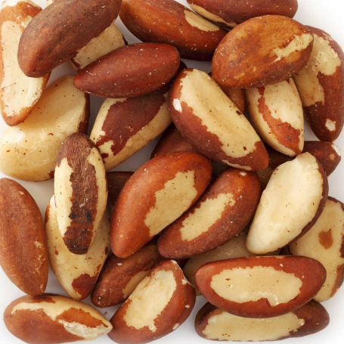
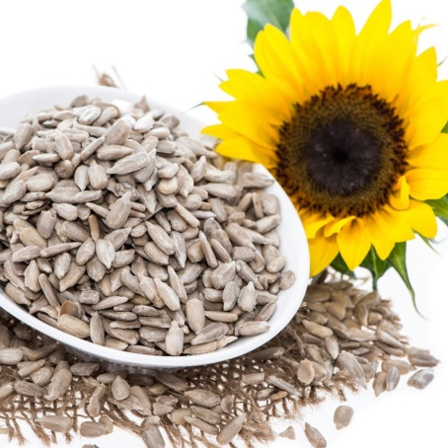
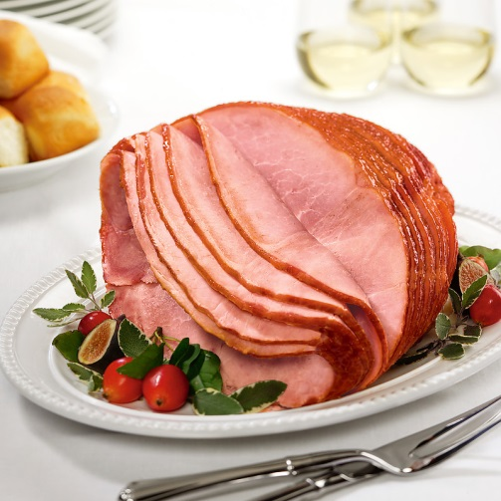
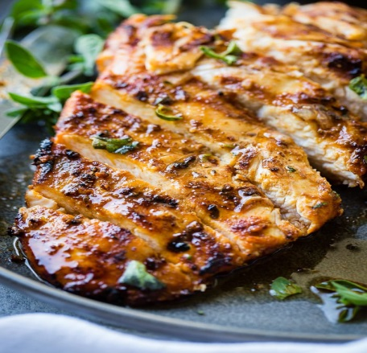
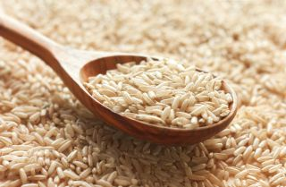
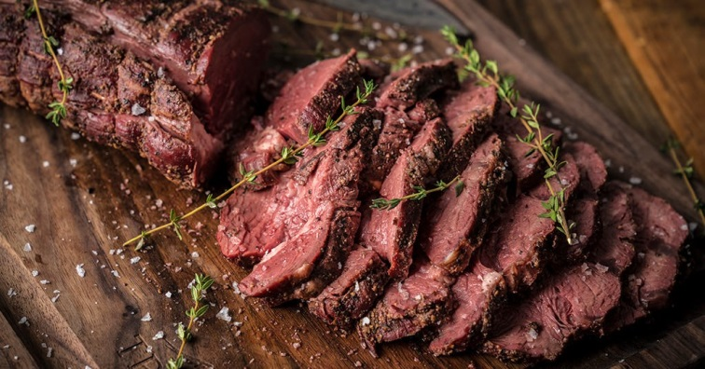
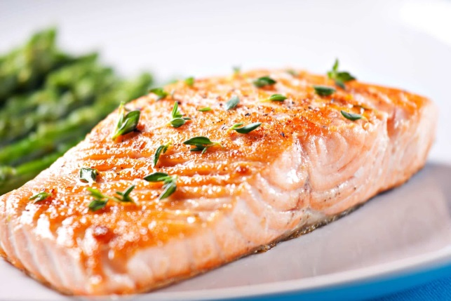
Foods with antiviral Activity foods boosts the immune system; don’t effectively kill bacteria and viruses
Common foods with selenium
Brazil Nuts
Sunflower Seeds
Ham / Pork
Poultry
Beef
Fish
Brown Rice
Eggs

Slide 10
macronutrients
Protein- we need 60-80 grams of protein daily
1 oz. protein = 7 grams
3 oz. protein = 21 grams
Sources of protein
Animal (meat, fish poultry, eggs and dairy)
Plant (soy, lentils, beans, nuts and seeds, quinoa)

Slide 11
Macronutrients
Carbohydrates
Whole grains
Fruits
Vegetables
Fats-choose monounsaturated fats
Canola oil/safflower oil
Olive oil
Avocados
Nuts

Slide 12
Eat in the right order
Protein
Fruits and Veggies
Whole grains

Slide 13
food and priorities
Food decisions based on emotions, budget and availability
Family pyramid

Slide 14
Continuity of medical care
Our responsibility as a practice is to provide you with medical and emotional support
We are here for you
We are on the front lines for you

Slide 15
Stress eating & Working From Home
Maintain routine- wake up and bedtime
Schedule meals and snacks to help control hunger
Remember to hydrate through out the day
Make time for activity

Slide 16
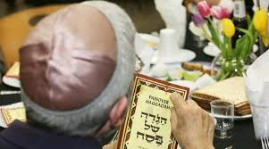
Spring holidays Celebrations
Let’s celebrate!
Plan a virtual family gathering
Organize a special family activity

Slide 17
How to handle emergencies
Call 911 if life threatening and imminent
Call 800-200-5553 ( 24/7)
For medical concerns during the day text:
Dr Andrei (732) 221-0504
Pamela (973) 900-7560
Adrianna (917) 732-3263
Andy (973) 900-7691

