Slide 1
Today during the meeting Please Text us your questions And/or comments
(800) 200-5553
Text us with your questions and comments!

Slide 2
Pamela’s Corner

Slide 3
whole person approach
Take time to listen to your body’s cues
We need to take care of our whole body

Slide 4
Take care of your body and mind
Trying to preserve some sense of normalcy is important for well-being
Good mental health promotes good physical health
Every little bit of movement counts

Slide 5
Focus on your breathing
It’s important to take a few moments and pause and just try to relax ourselves and our nervous system
Taking deep breaths helps improve lung capacity improves immunity.

Slide 6
Focus on your breathing
Essentially, the cleaner the blood, the harder it is for illnesses to stay put in your system.
When your blood is fully oxygenated, it carries and absorbs nutrients and vitamins more efficiently.

Slide 7
Improving Lung capacity
Diaphragmatic breathing
Relax your shoulders and sit back or lie down.
Place one hand on your belly and one on your chest.
Inhale through your nose for two seconds, feeling the air move into your abdomen and feeling your stomach move out. ...
Breathe out for two seconds through pursed lips while pressing on your abdomen

Slide 10
How to begin
You don’t need fancy equipment or a lot of time; you just need to weave exercise into your schedule
you can do simple activities every day to maintain your physical and mental health while isolating at home

Slide 11
Fun and easy ways to add activity to your day
Turn on some music and dance like nobody is watching
Do squats during commercials while watching tv
Do side lunges while putting clothing in the dryer
March in place or go outside for a walk

Slide 12
Websites and apps
YouTube
Body Project
Walking Cardio
Jane Fonda
1 Mile Happy Walk (Leslie Sansone)
Apps
Beginner’s Workout (Power 20)
Seven – Quick At Home Workouts
Yoga for Beginners | Mind+Body

Slide 13
Stress eating & Working From Home
Maintain routine- wake up and bedtime
Schedule meals and snacks to help control hunger
Remember to hydrate through out the day
Make time for activity

Slide 14
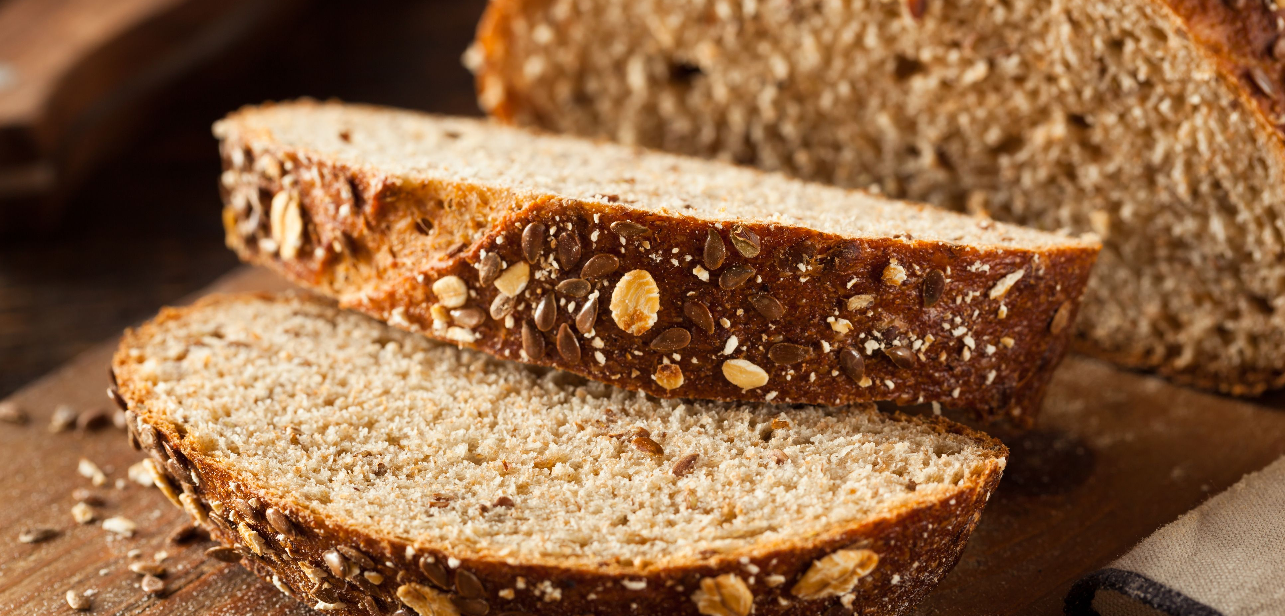
Fuel your body for immunity
Eat lean protein, fruit and vegetables
Choose whole grain varieties of breads, cereal and pasta
Eat every three hours to control blood sugar and hunger

Slide 15
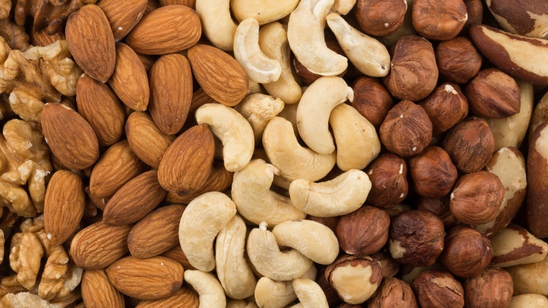
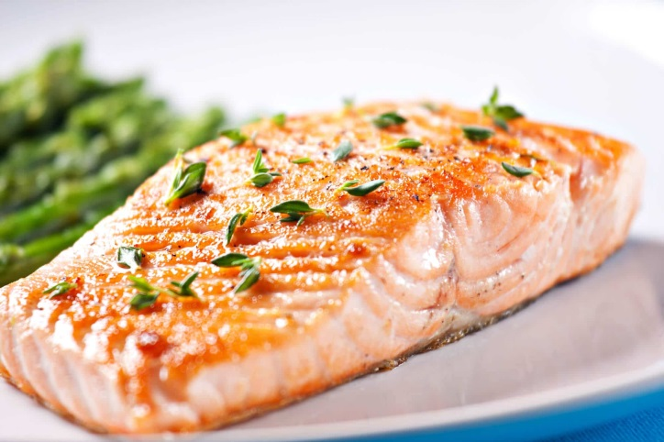
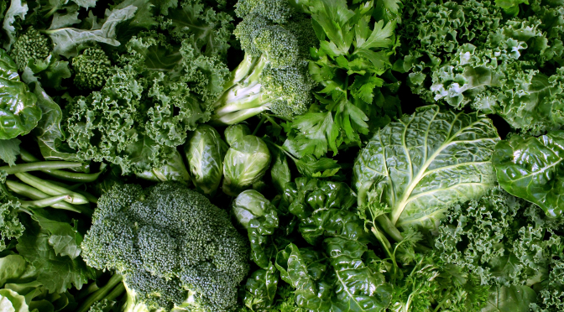
Antioxidant rich foods
Grapes
Blueberries
Red Berries
Nuts
Carrots
Tea
Fish
Dark Greens

Slide 16
hydration

Slide 17
Just remember…
WE’VE GOT THIS!

Slide 18
How to handle emergencies
Call 911 if life threatening and imminent
Call 800-200-5553 ( 24/7)
For medical concerns during the day text:
Dr Andrei (732) 221-0504
Pamela (973) 900-7560
Adrianna (917) 732-3263
Andy (973) 900-7691

